Slide 1
Responsible AI Use in Healthcare: Considerations for Faculty
by Elise V.Z. Lambert PhD, MHI, RHIA
Disclaimer: This presentation was refined using AI (ChatGPT-4o) & Gamma for clarity and coherence. However, all content was originally developed by the presenter.

Slide 2
Implementing Responsible AI Practices
Policy Development
Create clear institutional guidelines on acceptable AI use in teaching and assessment.
Faculty Training
Provide workshops on ethical AI integration and awareness of potential pitfalls.
Student Education
Teach proper AI use as a professional skill for future healthcare providers.
Continuous Evaluation
Regularly assess AI impact on learning outcomes and clinical reasoning development.

Slide 3
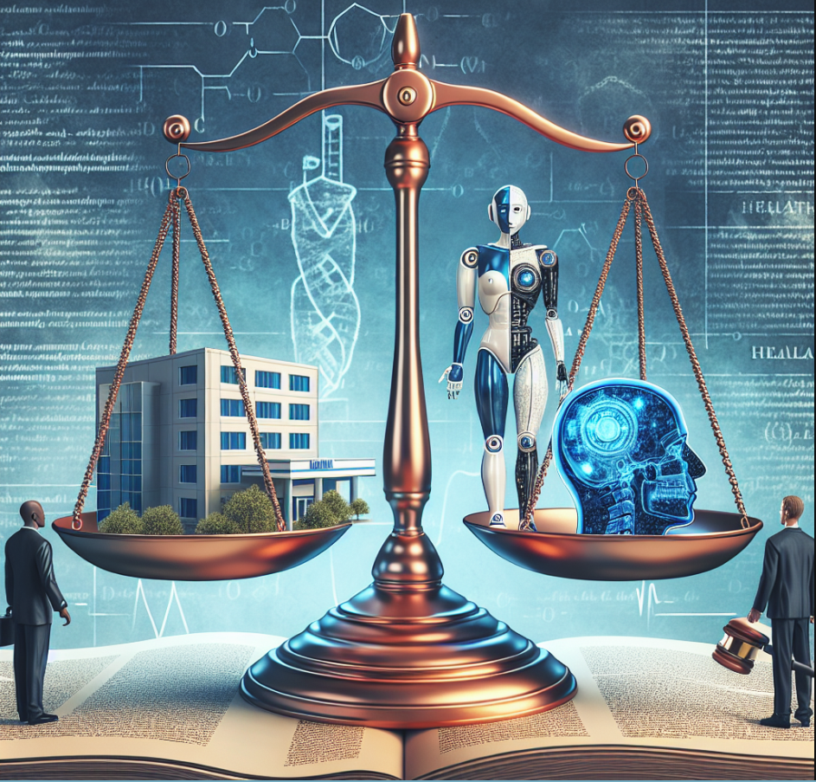
Plagiarism Concerns with AI
1
Identification Challenge
AI writing increasingly mimics human patterns. Detection tools struggle to keep pace.
2
Academic Integrity
Students using AI without disclosure undermines learning objectives and assessment validity.
3
Attribution Standards
Cite AI tools like any source. Include model name, version, and prompt details.
4
Verification Practices
Faculty should implement oral defenses or in-class components to validate student understanding.

Slide 4
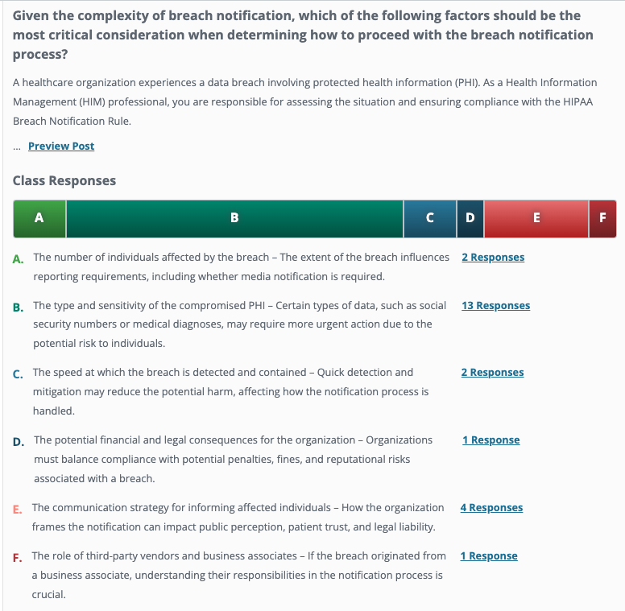
Example
Defense
Credible Sources
Reflective

Slide 5
Legal Aspects of AI in Healthcare Education
Institutional Liability
1
Will schools share responsibility for AI misuse
Professional Standards
2
Medical boards developing AI practice guidelines
Regulatory Compliance
3
HIPAA, state laws govern health data use
Legal Frameworks
4
Evolving legislation shapes permitted AI applications
Texas HB 1709 and FSMB guidelines establish boundaries for AI in clinical decision-making. Faculty must stay current on rapidly changing regulations.

Slide 6
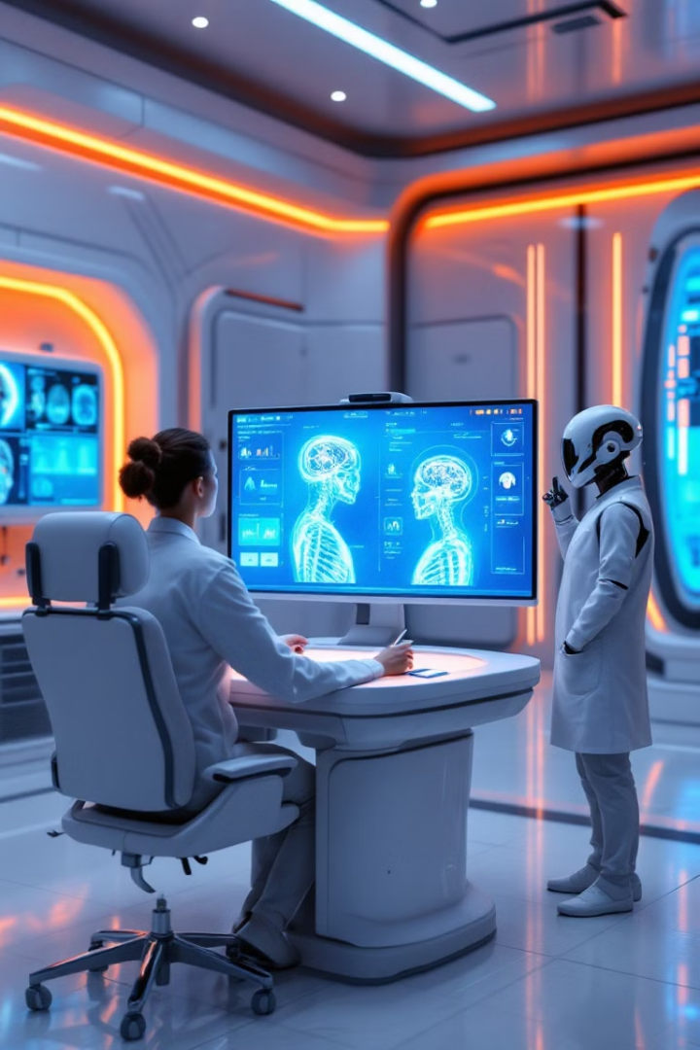
Understanding AI in HIIM
1
Automated Medical Coding
AI-driven coding software analyzes clinical documentation and assigns appropriate medical codes (ICD-10, CPT) with greater accuracy and efficiency.
2
Revenue Cycle Optimization
Machine learning models predict claim denials, suggest corrections, and improve reimbursement accuracy to reduce revenue leakage.
3
Fraud Detection & Compliance Monitoring
AI systems detect billing anomalies, flag fraudulent claims, and ensure regulatory compliance with HIPAA and other healthcare standards.
4
Clinical Documentation improvement (CDI)
AI-powered natural language processing (NLP) tools enhance documentation by identifying missing or unclear details in electronic health records (EHRs).

Slide 7
Assignment Example
This Photo by Unknown Author is licensed under CC BY-SA
This Photo by Unknown Author is licensed under CC BY-NC
This Photo by Unknown Author is licensed under CC BY-SA-NC

Slide 8
References:
Department of Education: https://www.ed.gov/media/document/avoiding-discriminatory-use-of-ai.pdf
Federation of State Medical Boards: https://www.fsmb.org/siteassets/advocacy/policies/incorporation-of-ai-into-practice.pdf
Gamma. (2025). AI-powered presentation design. Gamma. Retrieved March 15, 2025, from https://gamma.app
HTI-1: https://www.healthit.gov/isp/united-states-core-data-interoperability-uscdi#draft-uscdi-v6
OpenAI. (2025). ChatGPT (Version 3.5) [Large language model]. https://openai.com
OpenAI. (2025). DALL-E 3 [Image generator]. https://openai.com/index/dall-e-3/
TX House Bill 1709: https://capitol.texas.gov/tlodocs/89R/billtext/html/HB01709I.htm?utm_source=chatgpt.com
Yale student example: https://www.govtech.com/education/higher-ed/yale-student-suing-over-accusation-of-improper-ai-use

Slide 9
Leveraging Machine Learning in CDIS Teaching and Learning
Renee M. Wendel, M.S., CCC-SLP
Professor of Instruction & Director of Clinical Education
Department of Communication Disorders
ThePhoto by PhotoAuthor is licensed under CCYYSA.

Slide 10
What is generative ai?
A type of AI that uses algorithms to create new content based on data it's been trained on.
Generates diverse content, including text, images, audio with human-like results.

Slide 11
Clinical Training in CDIS
At this point, primarily Chatbots
ThePhoto by PhotoAuthor is licensed under CCYYSA.

Slide 12
Example 1
I am a SLP working with a 45 year-old bilingual high school teacher named Maria Delgado. Maria is experiencing hoarseness, vocal fatigue, and difficulty projecting her voice after long days of teaching. She has no history of vocal trauma but her symptoms are consistent with vocal nodules. As the SLP, I will explain her diagnosis, discuss vocal hygiene, and therapy options, as well as address her concerns about how these issues are impacting her teaching. Please respond as Maria expressing her frustrations, concerns, and asking about treatment options while I respond with appropriate guidance and solutions. Do not include my responses as the SLP, allow me to practice this conversation with a client.

Slide 16
ThePhoto by PhotoAuthor is licensed under CCYYSA.
AI Prompts (ChatGPT) for Busy Educators

Slide 17
Considerations
Pedagogy shifts
Job displacement
AI Literacy (where do we learn it?)
Research Ethics / Academic Integrity
Privacy of data
Equity and access

Slide 18
NSF Grants to Introduce AI to Students and Faculty
Barbara Hewitt

Slide 19
Grants
Expand AI
Build models
General AI
AI in
Healthcare
Criminal Justice
Expand knowledge (anyone @ TXST) about AI
AI training sessions in May – apply to attend
STEM-CLEAR
Expand knowledge of non-STEM majors
Provide learning tools to non-STEM professors to teach non-STEM students
Agriculture
Health
Communications

Slide 20
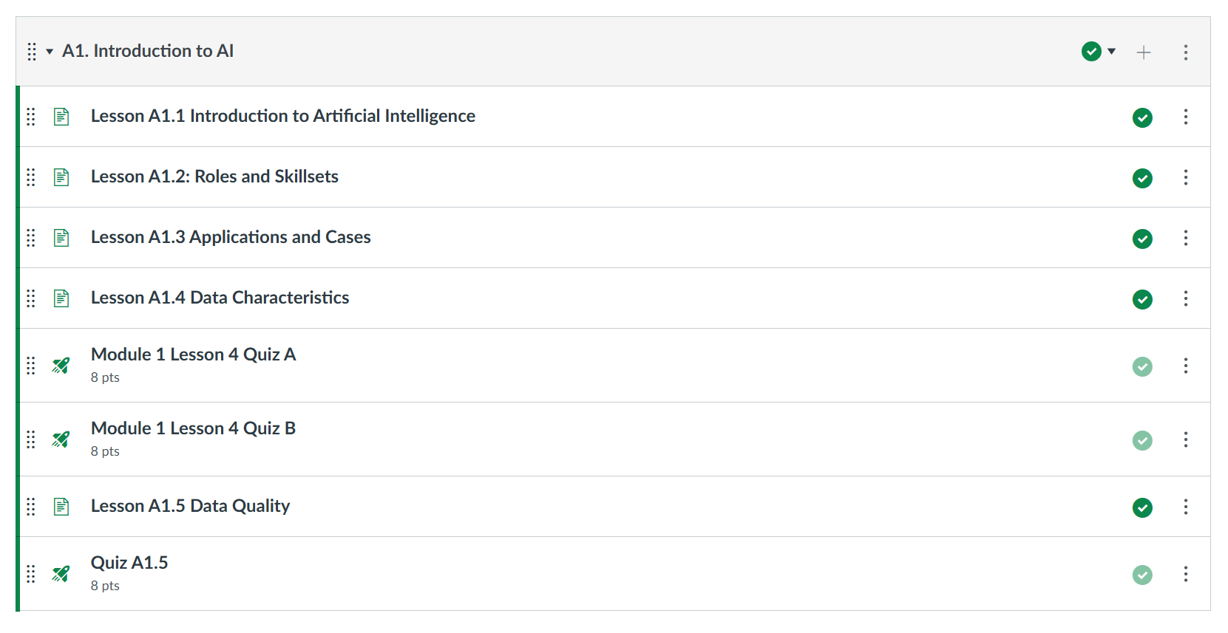
Expand AI Modules

Slide 21
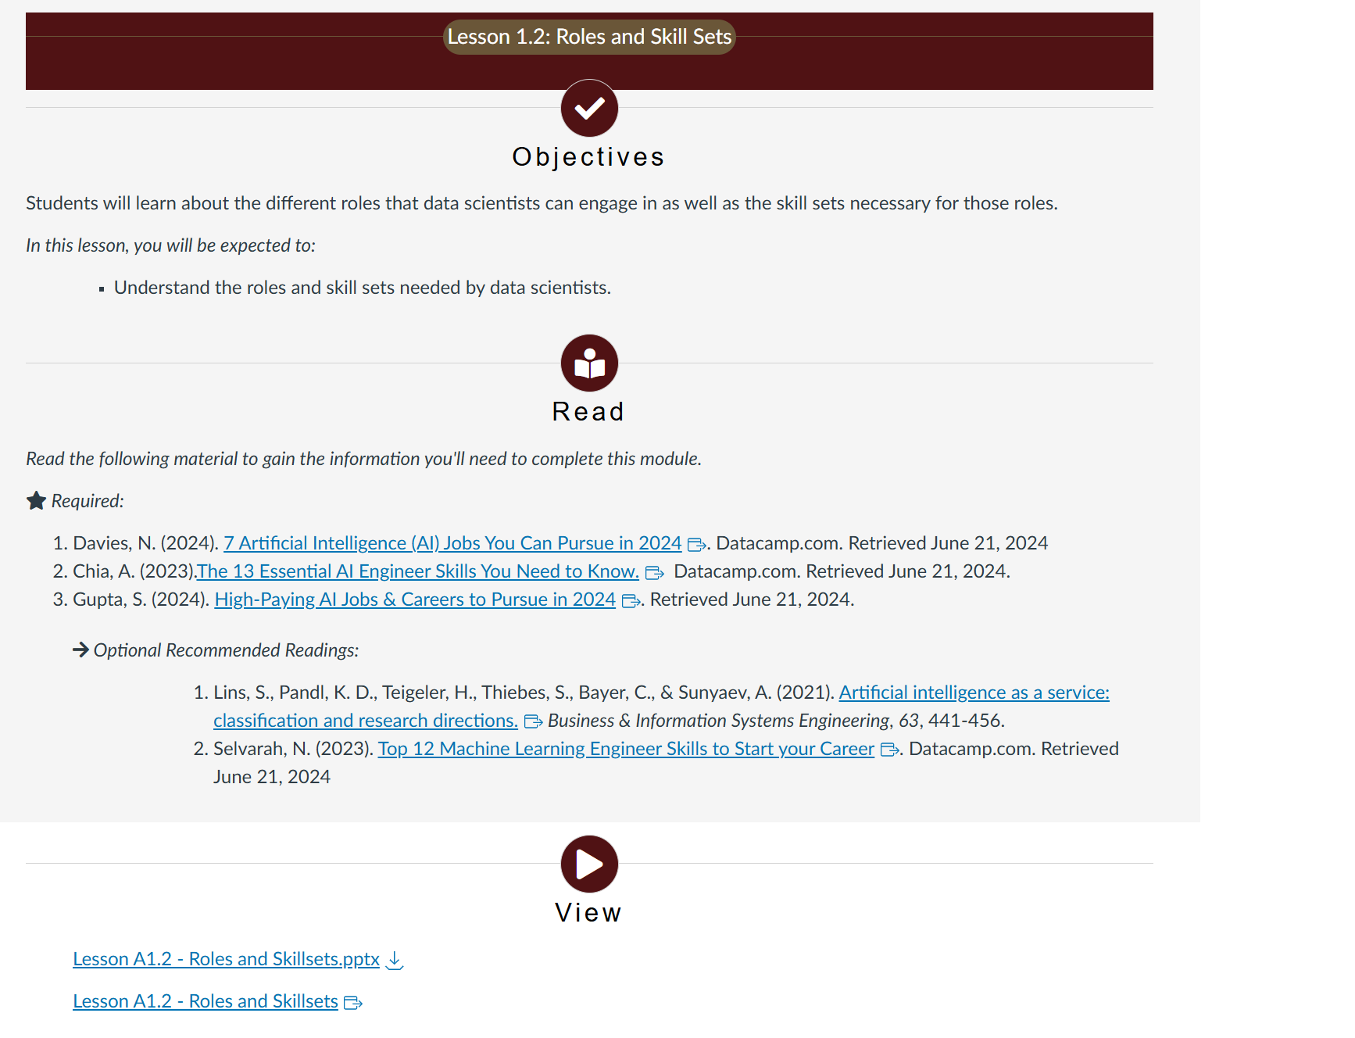
Each Lesson
Objective
Readings
Lectures
Quizzes (some weeks)
Can help with assignments

Slide 22
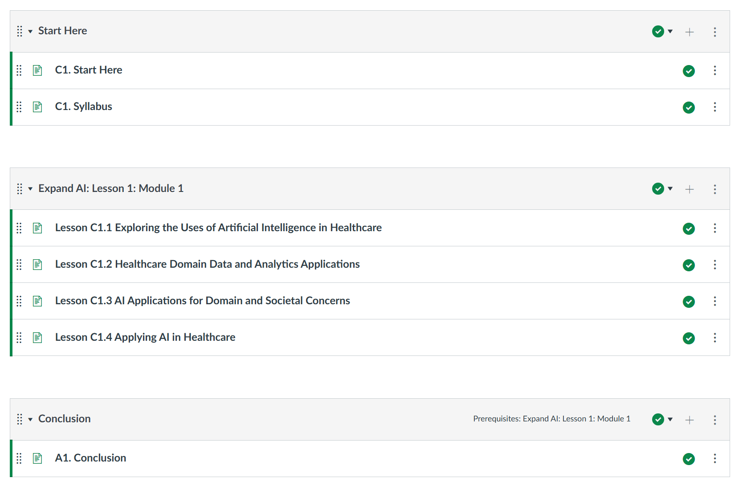
Expand AI - Healthcare

Slide 23
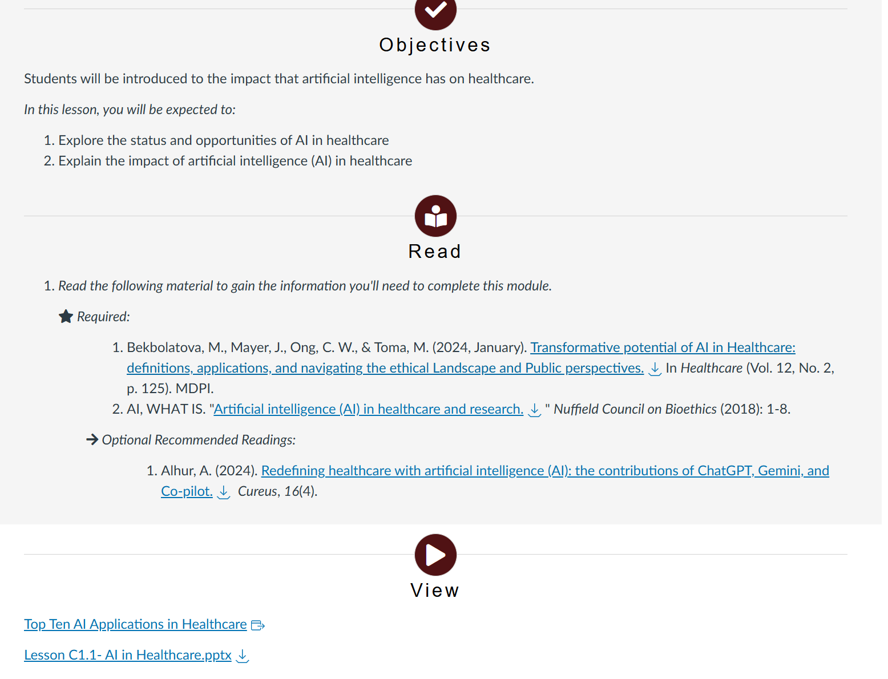
Lesson 1: Exploring the Uses of Artificial Intelligence in Healthcare

Slide 24
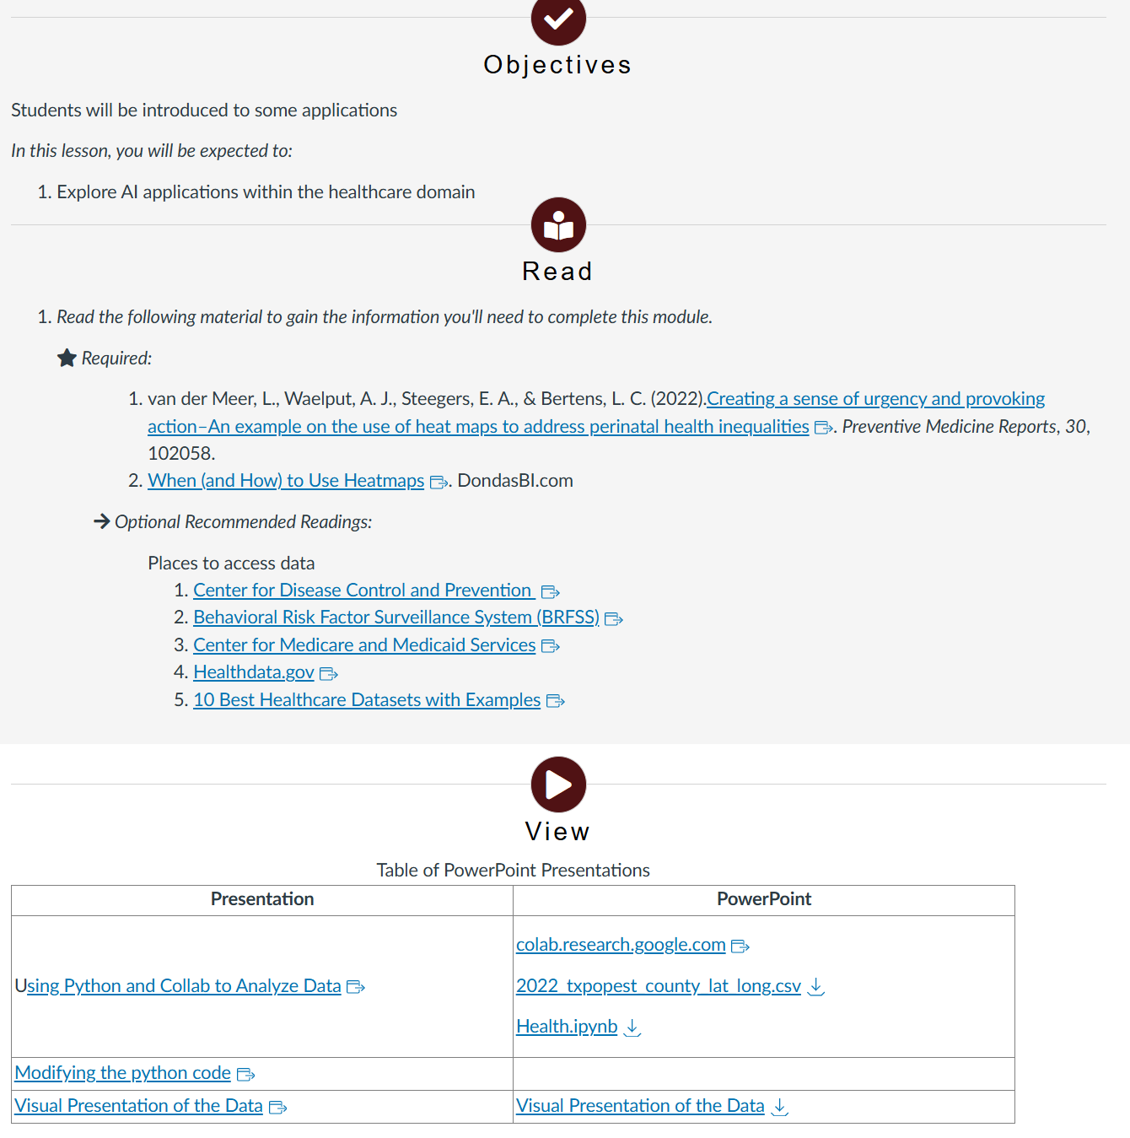
Lesson 3: Applying AI in Healthcare

Slide 25
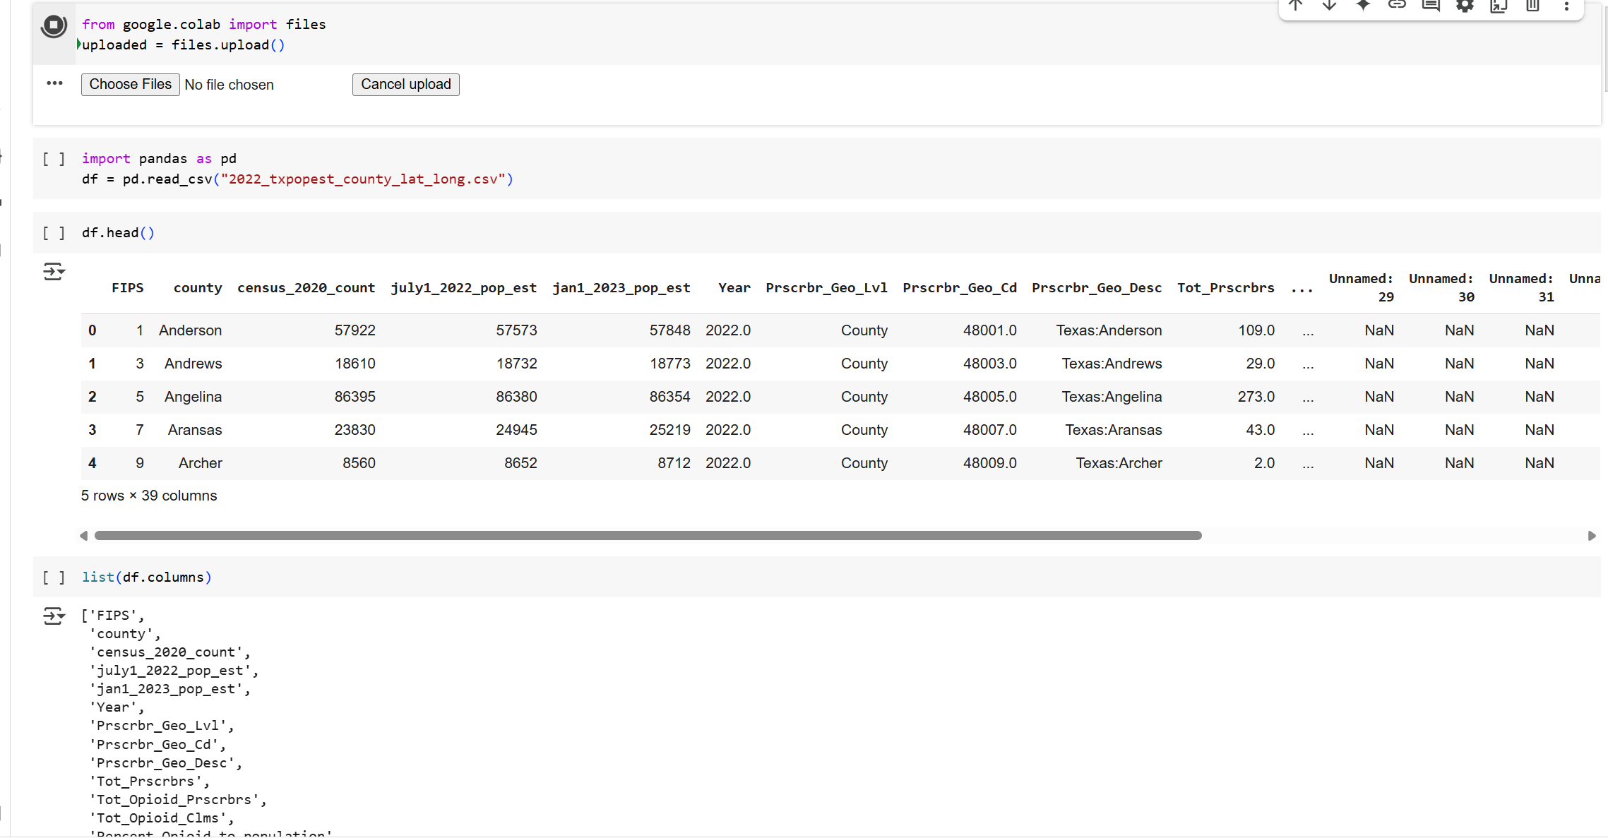

Slide 26
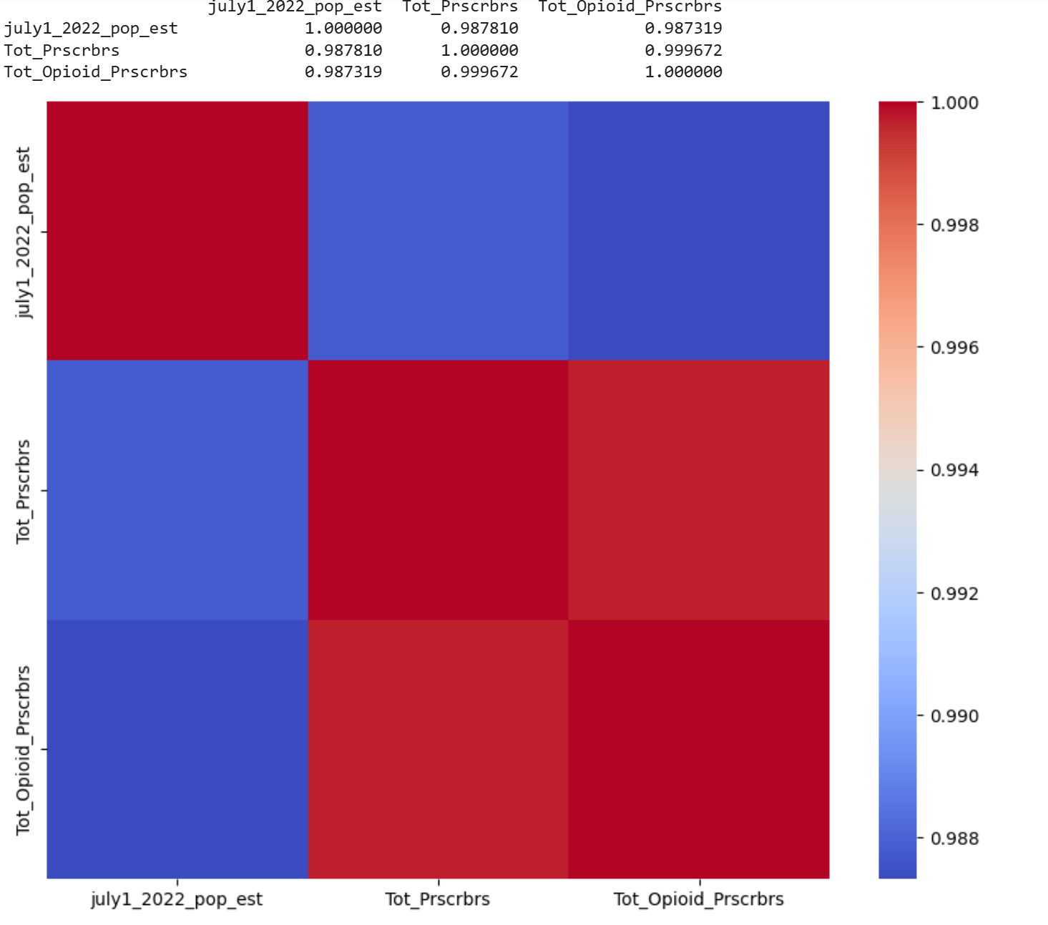

Slide 27
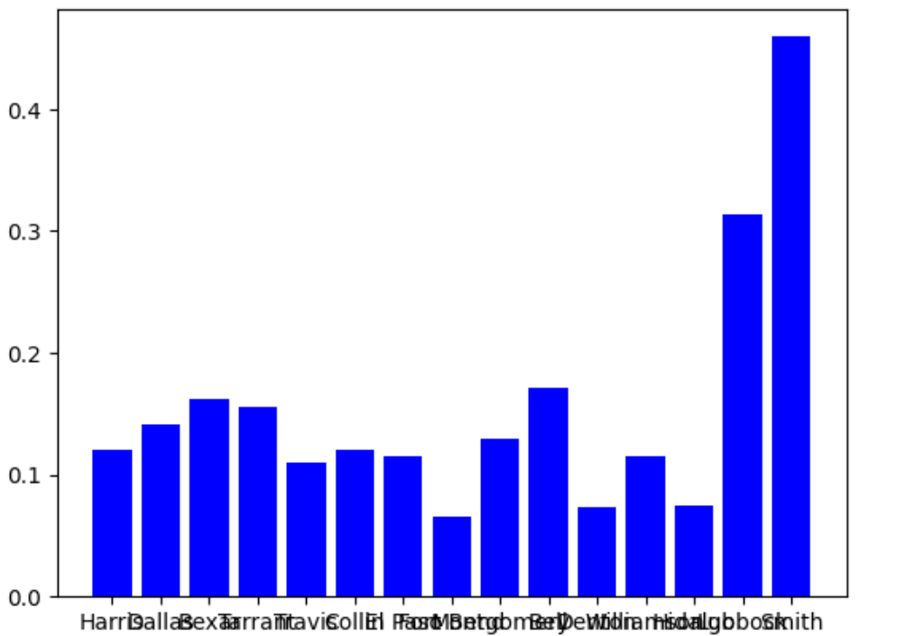
Opioid scripts written/population of county

Slide 28
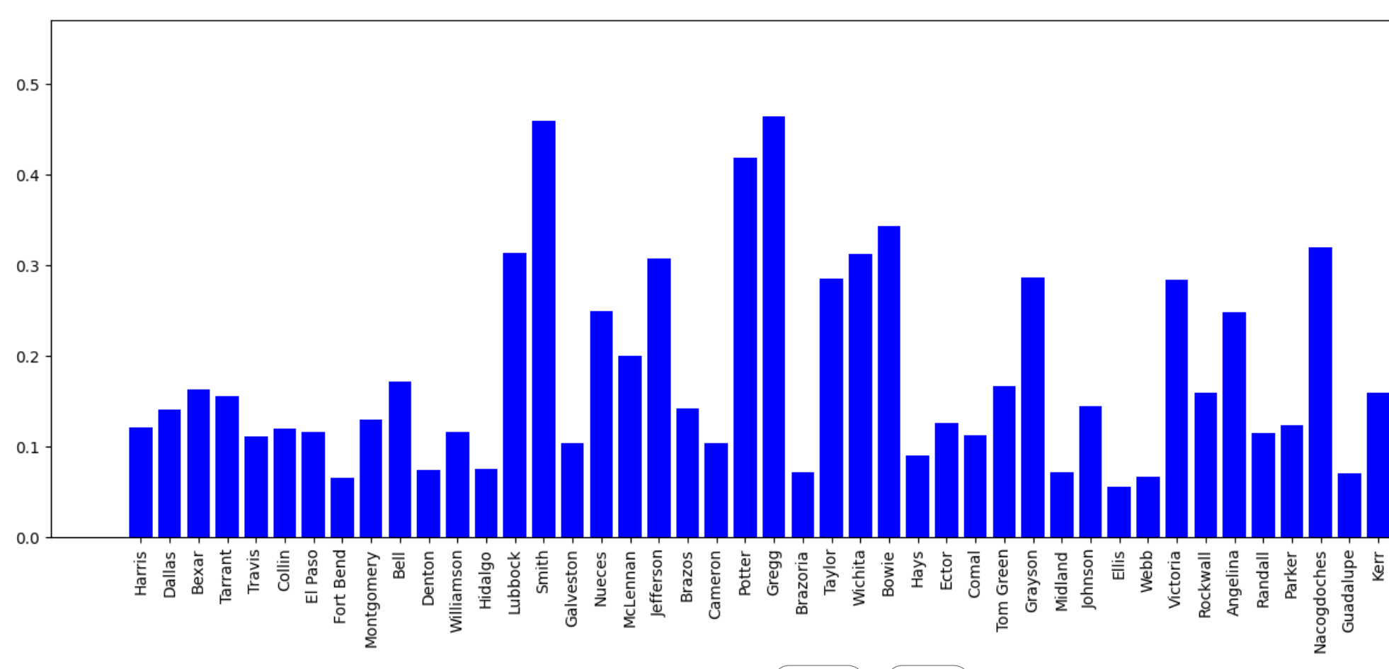
Opioid scripts written/population of county

Slide 29
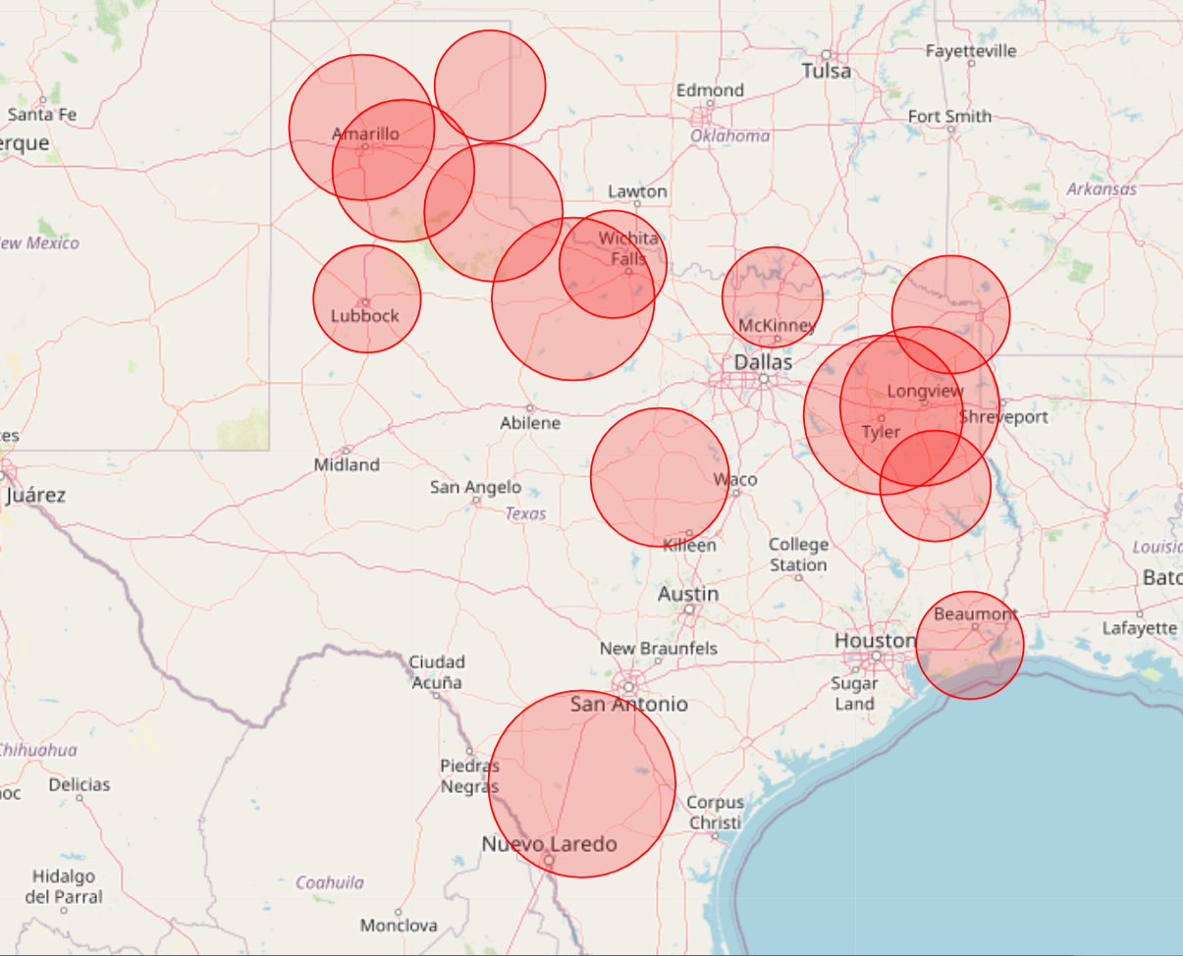
Bubble chart of counties with highest opioid scripts/county population

Slide 30
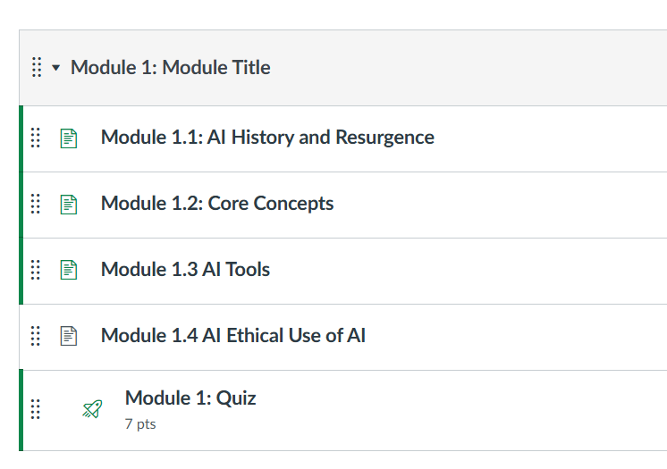
STEM-CLEAR
Expand teaching of AI to non STEM majors
Similar modules
Introductory module for all
Next AI in Healthcare

Slide 31
Questions?

